Slide 1
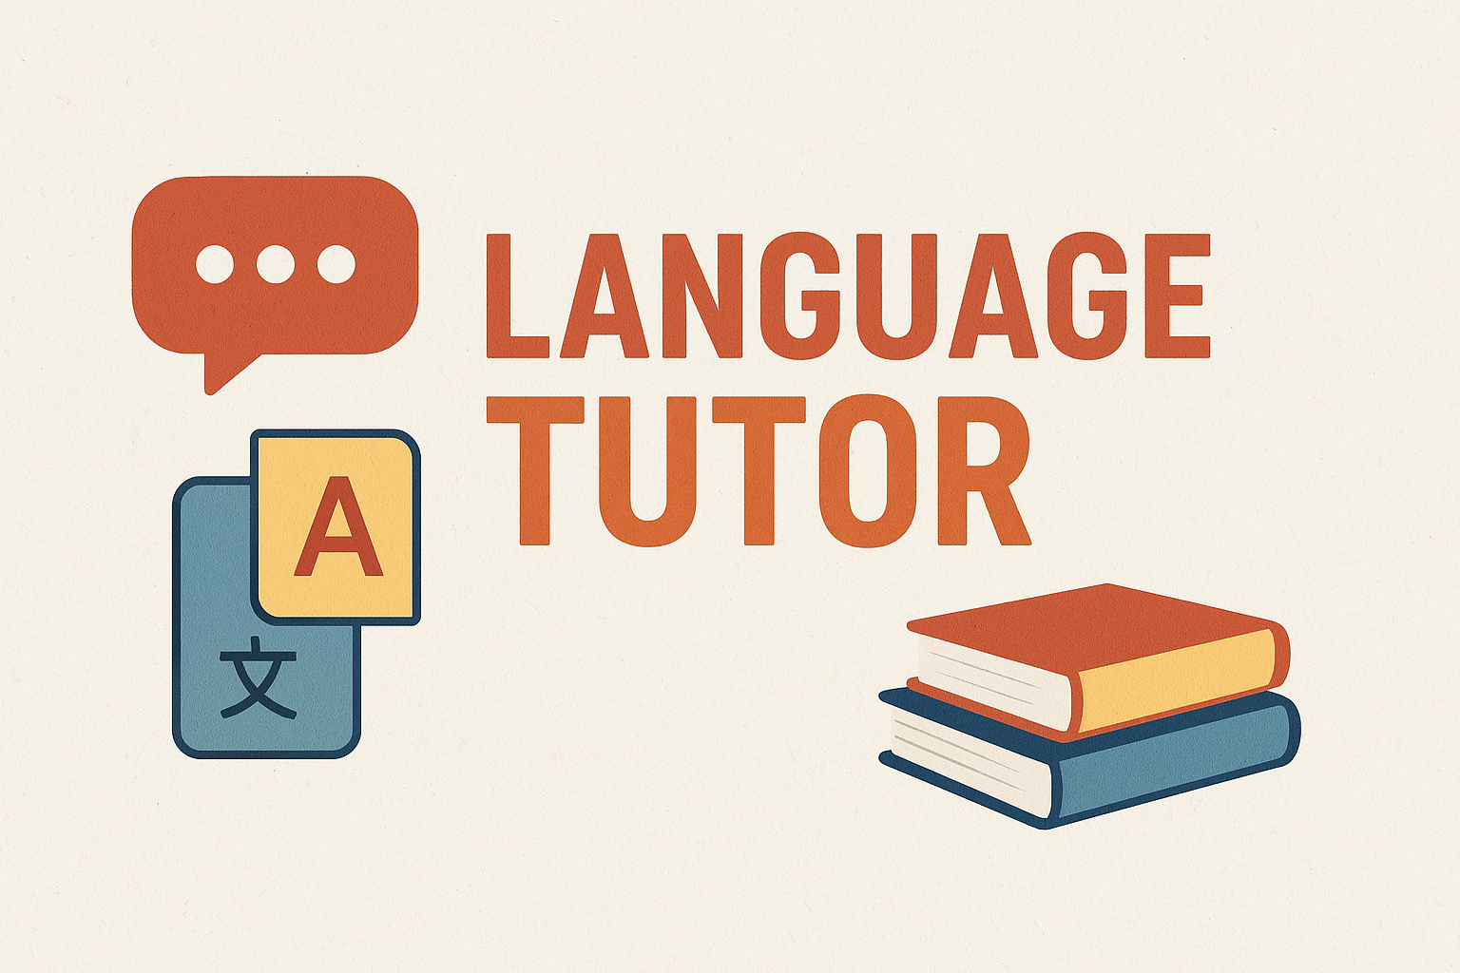
LANGUAGE TUTOR CHATBOT
Edin Hodžić

Slide 2

LearnBuddy is an interactive web application designed as a personal language-learning tutor. Through a modern and minimalist design, it allows users to easily communicate with the AI tutor. The application uses a chat interface where users can send sentences and receive corrections in real time. LearnBuddy offers predefined short messages (presets) for quickly starting conversations or exercises. Each AI tutor message is displayed with formatted text, including lists, highlighted text, and explanations. Users can enter their own sentences in the input field and send them by pressing Enter or the Send button. The application uses JavaScript for dynamically displaying messages, a typing indicator, and automatic scrolling. The UI includes a top bar with shortcuts, a chat panel with messages, and a composer for text input. LearnBuddy supports conversation simulations, suggests vocabulary, and provides short practical exercises. The goal of the application is to give students an efficient and practical way to learn a language in real time.

Slide 3

Main Features: Sentence correction Exercises and tasks Vocabulary by topics Conversation simulations

Slide 4

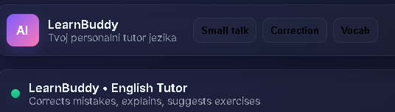
User Interface (UI)
Topbar
Contains the application logo and the name LearnBuddy
Displays shortcuts for quick access to features: Small Talk, Correction, Vocab
Allows quick selection of the type of interaction with the tutor
Chat Panel
Displays messages from the user and the AI tutor in different styles
Bot messages support formatted text, lists, and highlighted words
Messages automatically scroll down, and the AI shows a “typing indicator” while responding
Composer
Field for entering sentences or questions
Send button to submit a message and New Chat button to start a new conversation
Supports input via keyboard or click, making interaction easy

Slide 5
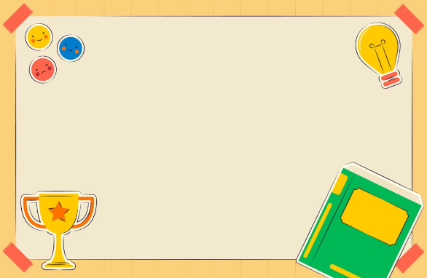
TECHNOLOGY: LearnBuddy combines modern web technologies to provide an interactive language-learning experience. The application uses HTML and CSS to structure and style the interface, ensuring a responsive design that works on different devices. JavaScript is used for dynamic chat management, message display, “typing indicator” animations, and automatic scrolling. The AI tutor connects via API calls, allowing real-time generation of responses and corrections. Bot messages support Markdown formatting, including lists, highlighted words, and short explanations. The goal of the technology is to create an application that is fast, modern, and easy to use, without the need for additional installations. Bullet points: HTML & CSS for responsive design JavaScript for interactivity and animations API for communication with the AI tutor Markdown support for rich text display

Slide 6

EXAMPLES OF USE
Users can use predefined short messages (presets) such as Small Talk, Correction, and Vocab for quick interaction. They can also enter their own sentences and send them by pressing Enter or the Send button. The AI tutor automatically corrects grammatical mistakes and provides brief explanations. Example: the user types “i im go to store,” and the AI returns: “I’m going to the store - corrected with explanation.” LearnBuddy can also suggest vocabulary exercises and simulate conversations in real-life situations.

Slide 7
EXERCISES AND TASKS: LearnBuddy is not only for sentence correction but also for interactive exercises that help users learn a language in a practical way. Users can: Get vocabulary by topics: travel, restaurants, work, school. Complete short tasks: Fill in the blank in a sentence Write the correct version of a sentence Find mistakes in a text Receive example sentences and context for new words, making them easier to remember. Practice through conversation simulations (role-play), e.g., ordering at a restaurant or booking a hotel.

Slide 8
ADVANTAGES
Personalized Language Learning The AI tutor tracks what the user writes and corrects sentences according to their needs.
Interactive Practice Role-play simulations (e.g., in a restaurant) help users learn through real communication.
Quick Corrections and Explanations The generateTutorReply function automatically corrects mistakes and explains rules.
Vocabulary Exercises Predefined messages (presets) allow for quick learning of new words and expressions.
Markdown Support and Clear Structure AI messages use headings, lists, and highlighted text, making lessons easier to follow.
Continuous Learning Without a Live Teacher Users can practice anytime without the need for a teacher’s presence.
Simple and Modern Interface HTML and CSS provide a responsive and clean design, while JavaScript ensures interactivity.
Automatic Scrolling and Typing Indicator Messages automatically scroll to new ones, and users see when the AI is responding.

Slide 9
CONCLUSION
LearnBuddy is a powerful language-learning tool that combines interactivity, practical exercises, and personalized corrections. Through a simple and modern interface, students can:
Practice communication in real-life situations (role-play)
Receive instant corrections and explanations of their mistakes
Learn new vocabulary through themed exercises
Build confidence in writing and speaking without a live teacher
Key Message: LearnBuddy makes the language-learning process easier, fun, practical, and more effective

